Slide 1

Introduction to Research Methods
Subject Code- FT-210 – Research Methods
Dr.Yamini Karmarkar
International Institute of Professional Studies
Devi Ahilya University
Indore

Slide 2
How does knowledge evolve?
Some examples:-
Newton, Einstein, Alfred Noble, C.V.Raman, and the list is endless……
Lord Keynes, Gustav Castle, Fischer, F.W.Taylor, Micheal Porter and many more……..
What is common among them?

Slide 3
“Enquiry” – the key for knowledge building
Occurrence
Questions
Occurrence
Questions
Questions
Questions
Questions
Occurrence
Occurrence
Questions
Answers to questions advance the body of knowledge

Slide 4
Basic objective of research is adding to the existing knowledge

Slide 5
Knowledge
Facts – Some phenomenon that has been observed
Laws – Universal generalization of facts
Theory – A systematic explanation of observations that relate to a particular aspect of life.

Slide 6

Types Of Research
Exploratory
  Initial research conducted to clarify and define the nature of a problem
  Does not provide conclusive evidence
  Subsequent research expected
Descriptive
  Describes characteristics of a population or phenomenon
  Some understanding of the nature of the problem
Causal
  Conducted to identify cause and effect relationships

Slide 7
Uncertainty Influences
The Type Of Research
CAUSAL OR
DESCRIPTIVE
COMPLETELY
CERTAIN
ABSOLUTE
AMBIGUITY
EXPLORATORY

Slide 8
Degree of Problem Definition
Exploratory Research Descriptive Research Causal Research
(Unaware of Problem) (Aware of Problem) (Problem Clearly Defined)
“Our sales are declining and “What kind of people are buying “Will buyers purchase more of
we don’t know why.” our product? Who buys our our products in a new package?
competitor’s product?”
“Would people be interested “Which of two advertising
in our new product idea?” “What features do buyers prefer campaigns is more effective?”
in our product?”
possible situation

Slide 9
Scientific Method of Research
Problem
Generalization
Hypothesis
Theory
Data
Analysis
Research
Design
Data
Collection
Measurement

Slide 10
Theory
Preposition
Concept
Concept
Variable
Variable
Hypothesis
Theories explain observation by means of concepts
Theory is a system of concepts and variables in which concepts are related to concepts by prepositions and variables are related to each other by hypothesis

Slide 11
Theory Building Process
Identify the phenomenon that is to be studied. (Literature review, interest of researcher etc)
Look Around - Do literature review to identify what is known about the phenomenon
GAP- Identify the areas where there is a possible gap in the existing literature – some unanswered questions are there
Focus - Develop focus on the problem and build a theoretical framework and a research design
Theory Testing – Empirical Research

Slide 12
Theory Building Process
Identify the phenomenon that is to be studied. (Literature review, interest of researcher etc)
Specify the boundaries, domains
Do literature review to identify what is known about the phenomenon
Identify the areas where there is a possible gap in the existing literature – some unanswered questions are there
Develop focus on the problem and build a theoretical framework and a research design

Slide 13
Theory Building cont…
Conceptualization & Operationalisation
Assessing the goodness of theory
Theory testing (Empirical research)

Slide 14
Approaches to Theory Building
Grounded
Theory
Inductive
Theory Building
Deductive
Theory Building
Disciplined Imagination

Slide 15
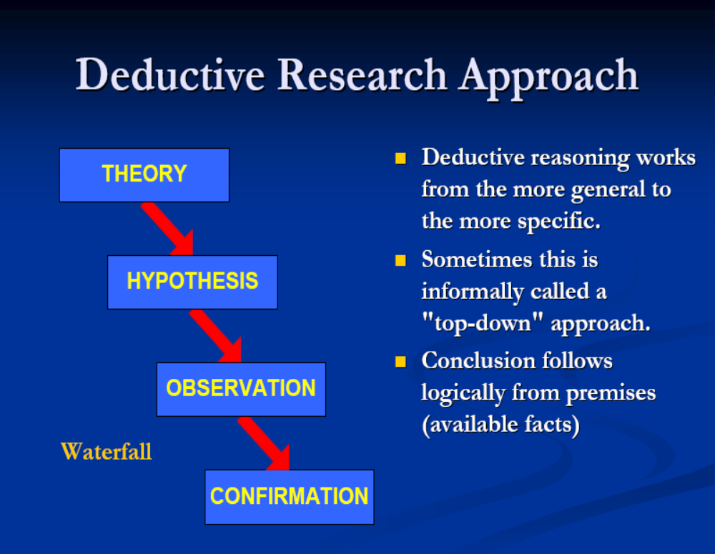

Slide 16
Deductive Reasoning
Reasoning from the general to the specific
For example, start with a general statement: All cars have tires.
You can apply this general statement to specific instances and deduce that a Maruti 800, Hyundai Verna, Ford Escort, a Toyota Camry, and a Mercedes Benz must have tires.

Slide 17
Premise 1 - All Birds have Wings
Premise 2 – All Crows have Wings
Therefore - All crows are Birds

Slide 18
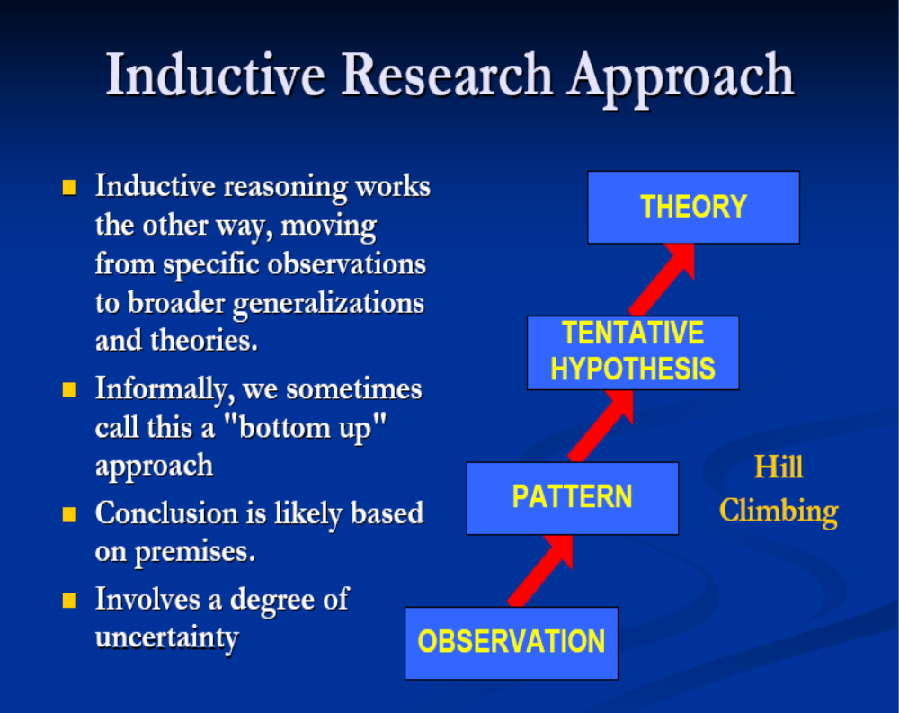

Slide 19
Inductive Reasoning
Reasoning from the specific to the general
Eg :- Crow A is Black
Crow B is Black
Crow C is Black
All crows are Black

Slide 20
Sherlock Holmes is an example of which type of reasoning?
Inductive Reasoning
He takes specific clues and comes up with a general theory

Slide 21


Slide 22
"Well begun is half done"
--Aristotle, quoting an old proverb

Slide 23
How to begin with a research?

Slide 24
_ntr_duc_ion to re_arch Met_od
Identification of GAP is must to begin a research.
There has to be a problem so that you can find the solution to it.

Slide 25
When designing a study
Choose an issue or problem
Relate it to the existing theory
Look at the other researches
Examine research and studies that relate to the problem
Write the question

Slide 26
What makes a good research question?
Is it interesting?
Is it researchable?
Is it significant?
Is it manageable?

Slide 27
How to refine the research question
Literature Review
Identification of GAP is the most important objective of Literature Review.
It is essential for both – Inductive as well as Deductive Research

Slide 28
Conducting the Literature survey
A two step process:-
  Identifying the RELEVANT resources
  Extracting and organizing the RELEVANT information

Slide 29
Operationalising the research
Developing a theoretical framework
Forming Tentative Hypothesis
Developing Research Design

Slide 30
Developing theoretical framework
Concept → Dimensions→ Element →Variables
Relationship Between Variables

Slide 31
Theoretical Framework
Performance of Student
Placement
Academic Performance
Participation in Extracurricular activities
Placement
Exhibition of Skills

Slide 32
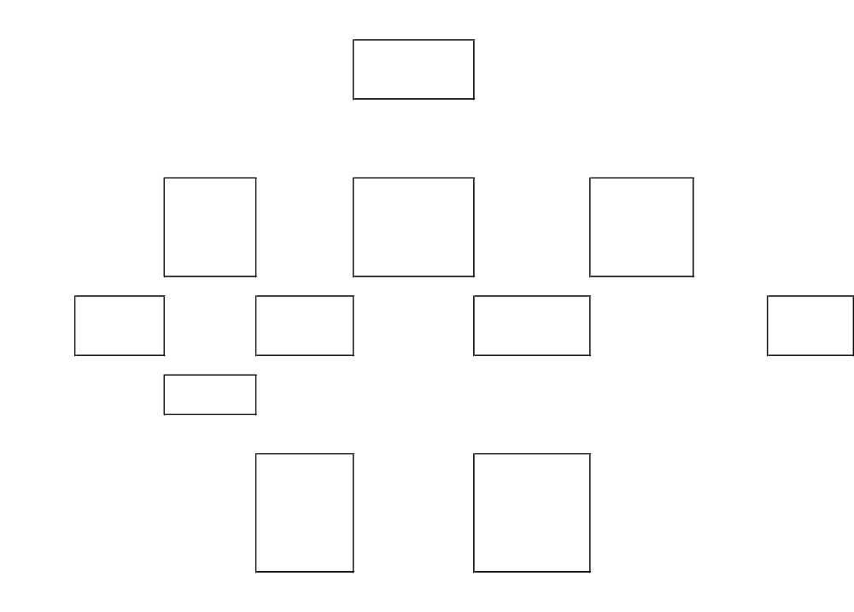

Slide 33
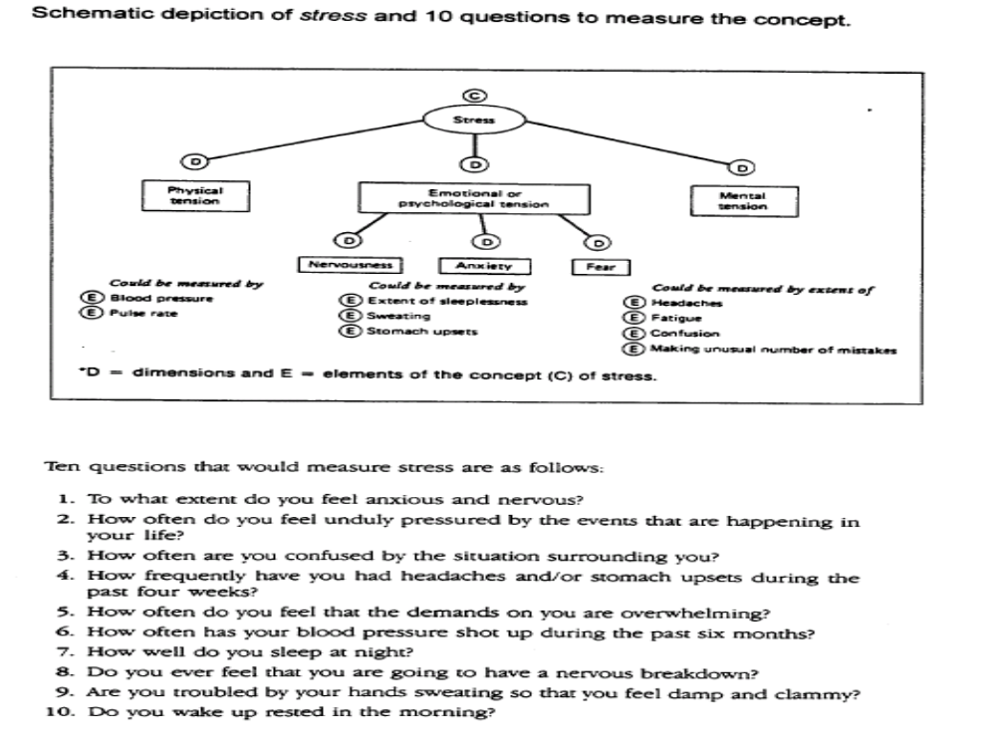

Slide 35
Things to do!
Types of variables
Types of relationships –
      Cause and effect
      Correlation
      Descriptive
How to measure?
Types of Hypothesis

Slide 36
The Research Design
Purpose of
the Study
Types of
Investi-
gation
Extent of
researcher
interference
Study
Setting
Measure
-ment
&
Measures
1. Feel
for Data
2. Good
-ness
Of
Data
3. Hypo-
thesis
Testing
Problem Statement
Unit of
analysis
(Population
to be
Studied)
Sampling
Design
Time
Horizon
Data
Collection
Method

Slide 37
Planning for the research
Measurement Design
Sampling Design
Data Analysis

Slide 38
Next Session
Define measurement and scaling
Different types of scales
Validity in measurement
Reliability in measurement
Details on questionnaire construction
Sampling Techniques

Slide 39
Happy Researching!

